Slide 2
Sustainable Cloud Migration
Best Practices

Slide 3





Light speaker slide
Christoph Acham

Slide 4

It’s so Fluffy
Concepts
Re-Iterate & Extend
Conclusion & Q&A
A Closer Look
Ask the Audience
Satellites

Slide 5
The Imperative of Sustainability
If Nothing Changes, Everything Changes

Slide 6
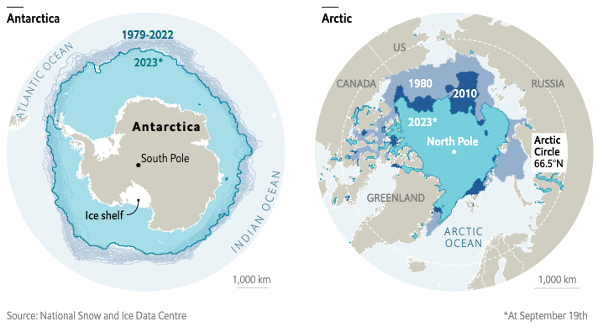
We Do Not Inherit the Earth from Our Ancestors; We Borrow It from Our Children

Slide 7
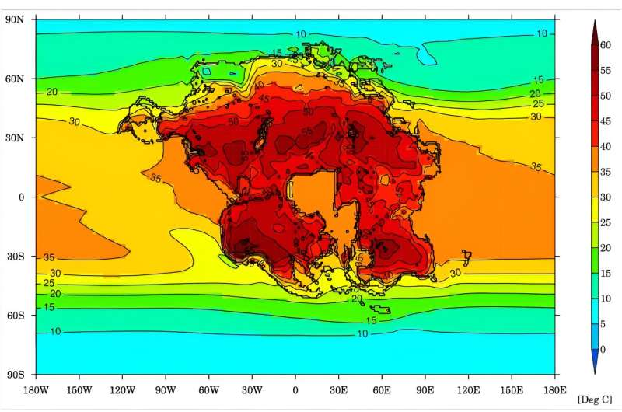
In 250 million years, Pangea Ultima could turn 92% of Earth barren.
a stark reminder of nature's grand scheme.

Slide 8
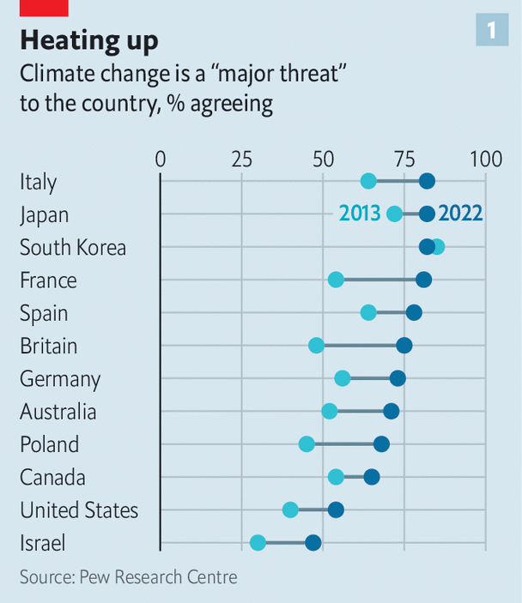
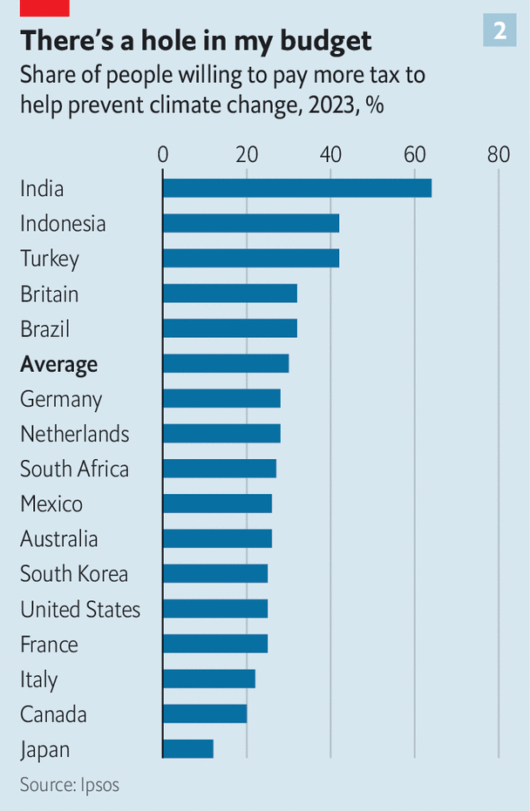
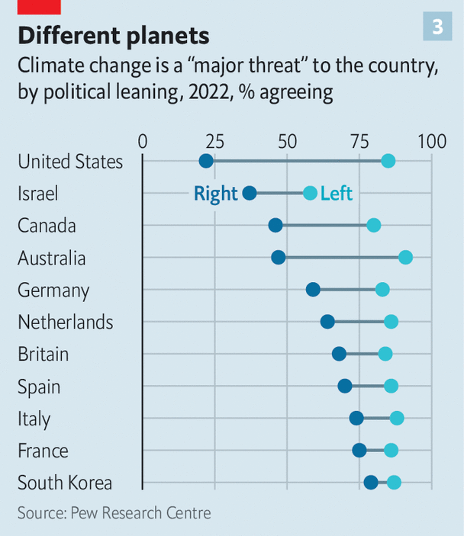
The global backlash against climate policies has begun
Cost, convenience and conspiracy-mongering undercut support for greenery

Slide 9
The global backlash against climate policies has begun

Slide 10
The global backlash against climate policies has begun

Slide 11
The global backlash against climate policies has begun
Cost, convenience and conspiracy-mongering undercut support for greenery

Slide 12

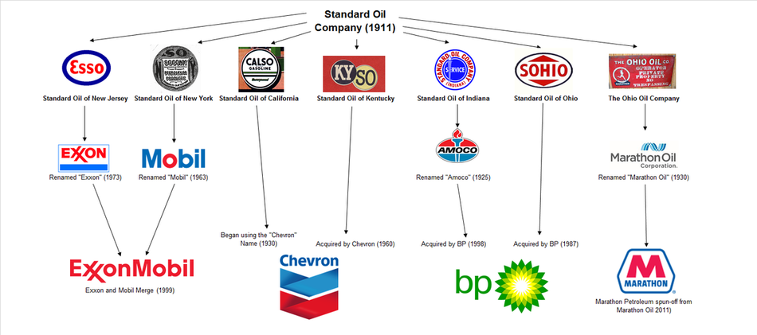

Exploitation
Sustainability
🌍
Never discover agriculture 10,000 years ago
Rockefeller’s Thriftiness
Crude Oil in Rivers
💤
💢
Colonialism
Laziness
Un-Sustainability

Slide 13
Cloud Sustainability

Slide 14
The discipline of sustainability addresses the long-term environmental, economic, and social impact of your business activities.
We Do Not Inherit the Earth from Our Ancestors; We Borrow It from Our Children

Slide 15
Exploitation
Sustainability
Let’s do uncomfortable work
Rockefeller’s Thriftiness
💤
💢
Laziness
Un-Sustainability

Slide 16
Sustainability Scopes in Cloud Migrations
Scope 1: Direct Emissions
Scope 2: Indirect Emissions from Electricity
Scope 3: All Other Indirect Emissions
As users, choosing a cloud provider with strong sustainability commitments can significantly reduce our own Scope 3 emissions.

Slide 17
Where Cloud Providers Stand
Google Cloud:
Committed to operating on carbon-free energy 24/7 by 2030
Leading in sustainability with active carbon footprint tracking for customers.
AWS:
Largest buyer of renewable energy.
Plans to power operations with 100% renewable energy by 2025.
Azure:
Microsoft's commitment to sustainability includes being carbon negative by 2030
And removing all of their historical emissions by 2050.

Slide 18
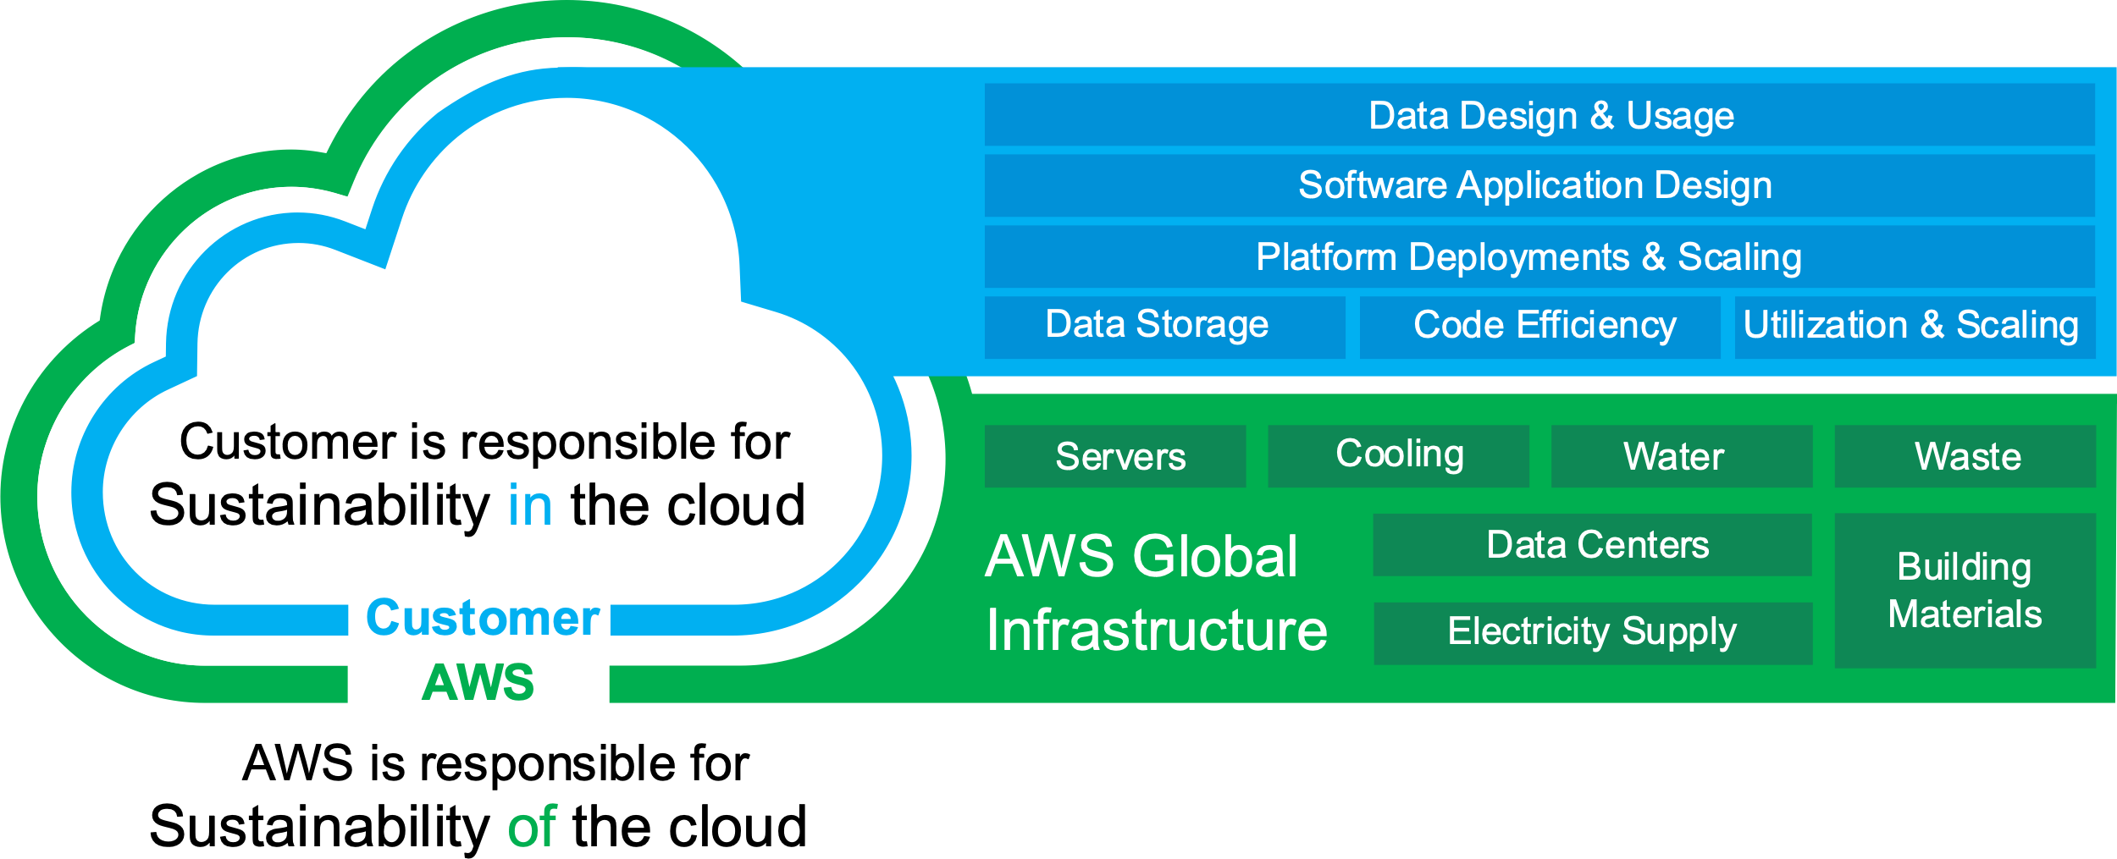

Slide 19
Data Storage
We are responsible for optimizing our data storage to ensure efficient use of resources.
For instance, using storage classes like S3 Intelligent-Tiering can automatically move data to the most cost-effective access tier without performance impact or or operational overhead.

Slide 20
Code Efficiency
Writing efficient code is crucial for reducing the computational resources required, thereby decreasing the energy consumption of applications.
An example includes refactoring legacy applications to run on serverless architectures like AWS Lambda / Azure Functions, which only uses compute resources when a function is invoked.

Slide 21
Utilization & Scaling
We must design our systems to scale efficiently in response to demand.
Auto Scaling groups in EC2 can adjust the number of instances automatically, ensuring you have the right number of EC2 instances available to handle the load or your application.

Slide 22
Optimize capacity for sustainability
A
B
C
Running in two zones you need to reserve enough spare capacity to rapidly switch the load for resilience

Slide 23
Optimize capacity for sustainability
A
B
C
Running in two zones you need to reserve enough spare capacity to rapidly switch the load for resilience

Slide 24
Optimize capacity for sustainability
A
B
C
Running in three zones you need less reserves capacity to switch the load

Slide 25
Optimize capacity for sustainability
A
B
C
Running in three zones you need less reserves capacity to switch the load

Slide 26
Platform Deployments & Scaling
When deploying platforms, customers should consider sustainable scaling practices.
For example, using containerization with services like ECS or EKS can optimize resource allocation, allowing multiple applications to share the same underlying resources effectively.

Slide 27
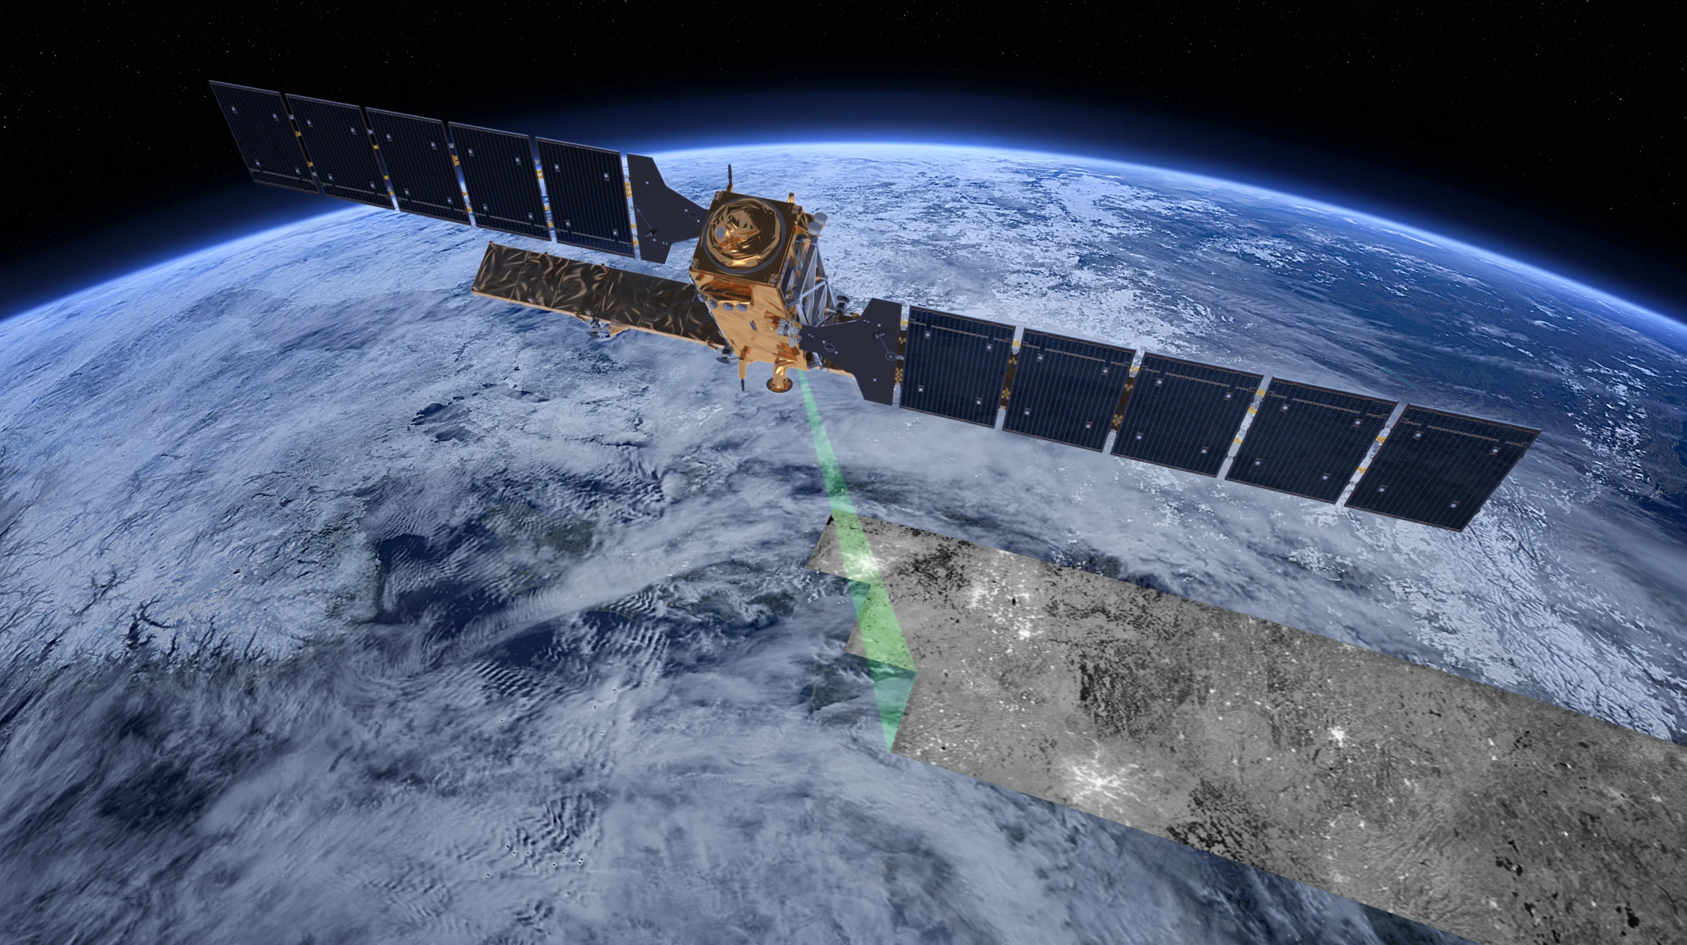

Slide 28


Slide 30
Software Application Design
Designing applications with sustainability in mind involves architecting solutions that minimize resource consumption.
This can involve using event-driven architectures that remain idle until a certain event triggers a computation process.

Slide 31
Data Design & Usage
We are tasked with designing data usage patterns that are sustainable.
Implement a data classification policy to identify data that is infrequently accessed can can help it move to colder storage options such as S3 Glacier, reducing storage costs and energy consumption.

Slide 32
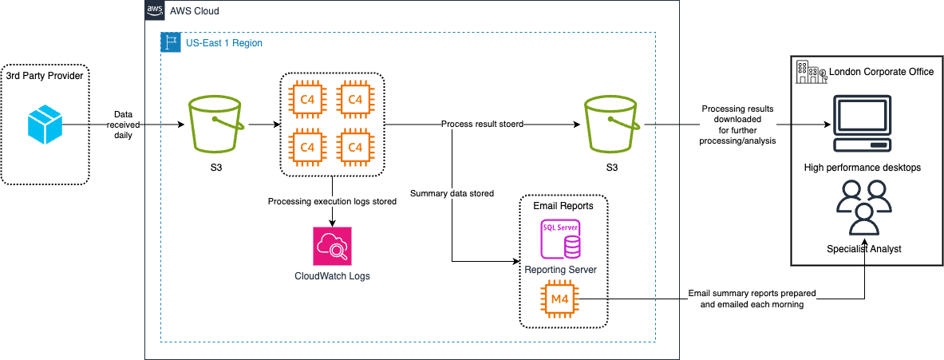
The X Renewable business unit daily collects operational data from its European wind farms through a third-party service. This data is merged with their own, then processed on a powerful computing system using traditional custom-built software. Specialists analyze the processed data on high-performance graphics workstations. Furthermore, the team produces daily reports and distributes them via email to the staff.

Slide 33

Pillar for Sustainability
Understand environmental impacts of the services used
Quantify impacts through the entire workload lifecycle
Apply best practices to reduce these impacts

Slide 34
User behavior patterns
Scale infrastructure with user load
Align service level agreements (SLAs) with sustainability goals
Eliminate the creation and maintenance of unused assets
Optimize the geographic placement of your workloads for user locations
Optimize team member resources for the activities performed

Slide 35
Software patterns
Optimize software architecture for asynchronous and scheduled jobs
Remove or refactor workload components with low or no use
Optimize the areas of your code that consume the most time or resources
Optimize impact on customer devices and equipment
Use software patterns and architectures that best support your data access and storage patterns

Slide 36
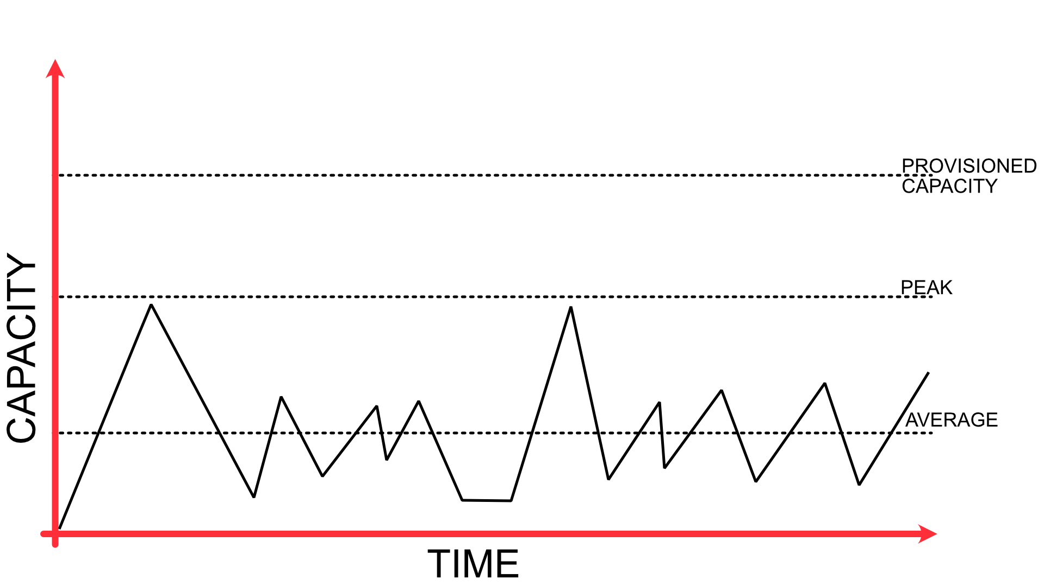
Impact depends on total provisioned capacity, not average utilization

Slide 37
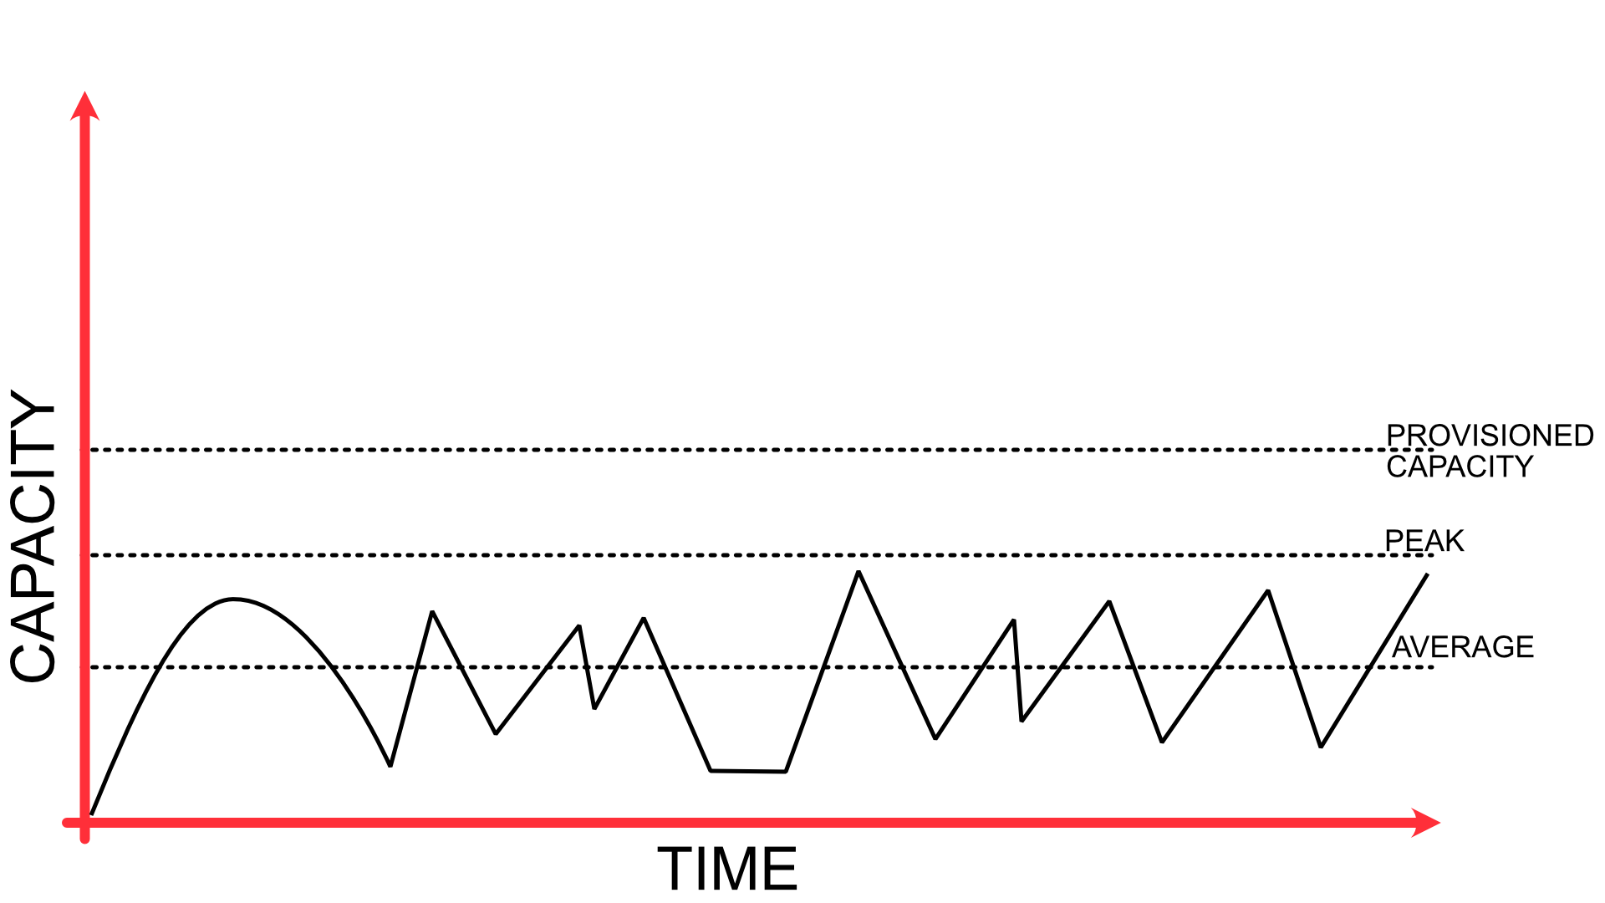
Impact depends on total provisioned capacity, not average utilization

Slide 38
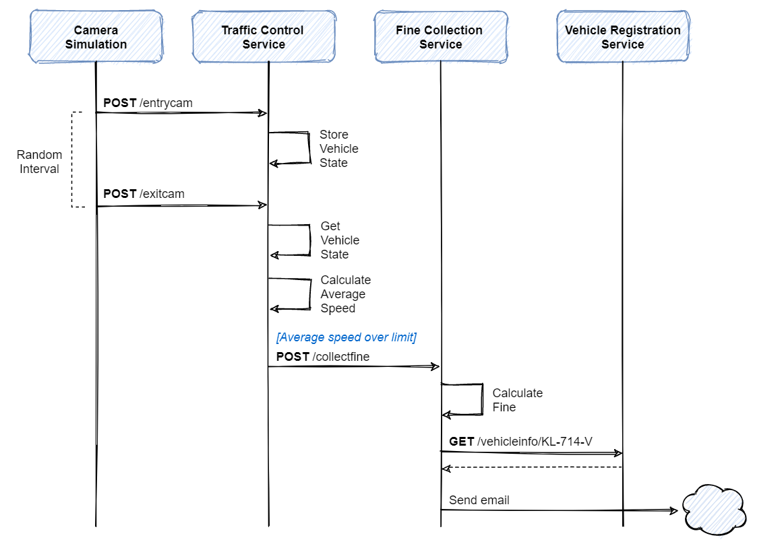

Slide 39
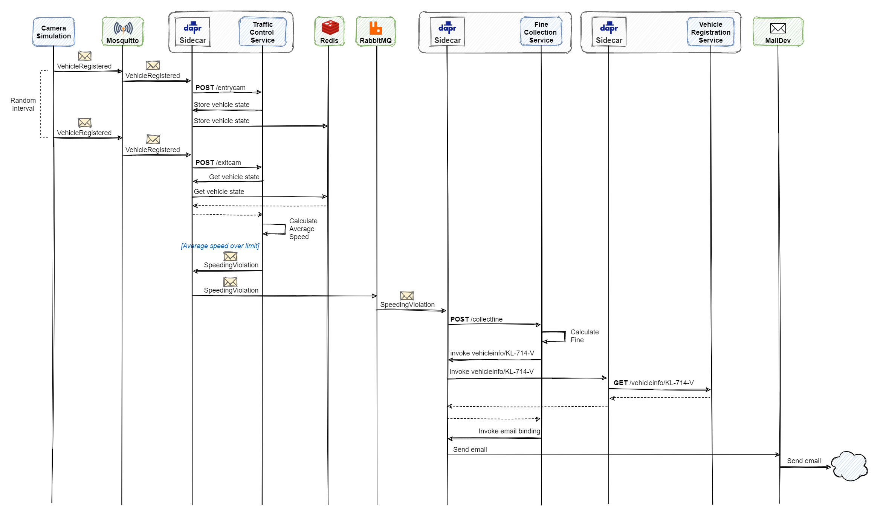

Slide 40
Hardware patterns
Use the minimum amount of hardware to meet your needs
Use the instances types that meet your requirements with the least impact
Use managed services
Optimize your use of GPUs

Slide 41
Development
Operations
Optimize Code
Choose faster language and runtimes
Efficient algorithms
Faster implementations
Reduce logging
Reduce retries and work amplifications
Higher Utilization
Automation
Relax over-specified requirements
Archive and delete sooner
Deduplicate data
Choose times and locations carefully

Slide 42
Development and deployment process
Rapid Introduction of Sustainability Improvements, think agile and CI/CD
Keeping Workloads Up-to-date
Optimize the use of Continuous Integration environments
Managed Device Farms for Testing

Slide 43
Honorable Mention
Microservices using Kubernetes Services (EKS, AKS)
Serverless Computing (Lambda, Functions)
Cost Management
Advisors
CI/CD Pipeline using GitHub Actions
Carbon Footprint Calculations
Monitor Energy Consumptions

Slide 44
Honorable Mention
Track Resource Utilization
Cost Analysis
Set Sustainability Goals
External Certifications

Slide 45
How you do anything is how you do everything
Scan that QA code

